Slide 1


Results from Arizona Space Grant's Participation in the Nationwide Eclipse Ballooning Project
Michael Fusco
AZ / NASA Space Grant Scholar
Embry-Riddle Aeronautical University

Slide 2
Overview
Project description
Tracking system
Payloads
Results
Conclusion

Slide 3
Project Description

Slide 4
Project Description (1 of 2)
Team part of Montana State University’s (MSU) Nationwide Eclipse Ballooning Project
Seven students involved:
  ERAU: Dakota Burklund (lead), Alan Davis, Steven Buck, Michael Fusco, Robert Velarde
  ASU: Bianca Pina, Paul Ronquillo, Jefferson Fleming
Faculty support
  ERAU: Jack Crabtree (project manager)
  ASU: Dr. Tom Sharp

Slide 5
Project Description (2 of 2)
Primary objective:
  Provide NASA a live video source of Moon’s shadow on the Earth’s surface from the high-altitude perspective to capture the “Great American Eclipse” on 21 August 2017
Initial systems were developed and provided by MSU
ERAU team made improvements to tracking and payload systems
ASU team developed a scientific payload
Team launched filmed eclipse from Glendo, WY

Slide 6
Tracking System

Slide 7
Tracking System (1 of 2)
Operation
  Ground station receives balloon’s position via APRS and Iridium
  Servos control the elevation and azimuth angles based on balloon’s location
  Location packets averaged 30 sec to 1 min apart

Slide 8
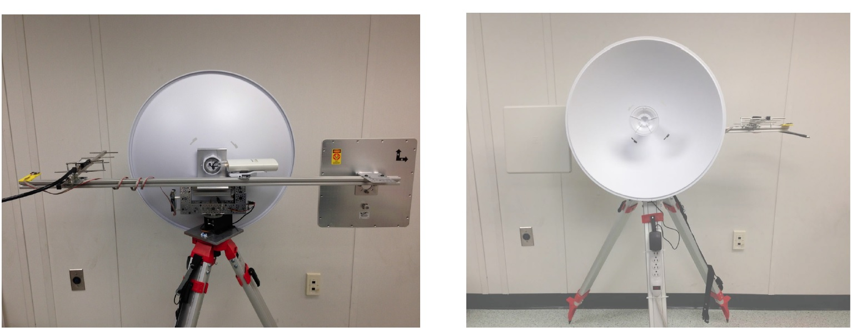
Tracking System (2 of 3)
Original MSU Tracking System, Front and Back View
Source: Montana State University [http://eclipse.montana.edu/about-the-systems/]

Slide 9
Tracking System (3 of 3)
Improvements
  Adaptation and modification of LSU’s tracking code
  Introduction of APRS beacons to system
  Manual user location input option
  Arizona Near Space Research (ANSR) tracking system was used for Digital Images over 2.4 GHz
  ANSR provided internet connection

Slide 10
Payload Systems

Slide 11
Payloads (1 of 6) – Digital Video
Objective
  Designed to live stream video of Moon’s shadow on Earth during the eclipse
Improvements
  Use of higher-gain patch antenna
  Addition of passive stabilizers

Slide 12
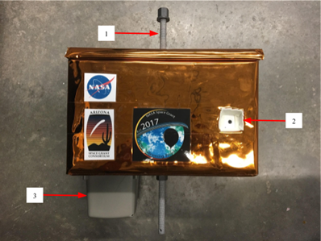
Payloads (2 of 6) – Digital Video
Digital Video Payload, External View

Slide 13
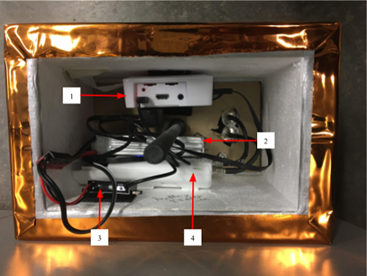
Payloads (3 of 6) – Digital Video
Digital Video Payload, Internal View

Slide 14
Payloads (4 of 6) – Digital Image
Objective
  Capture images of the Moon’s shadow on Earth’s surface
Modifications
  Rotate camera to view the Earth’s surface and the horizon
  Horizontal view provides greater perspective of the event
  Transmit images on 2.4 GHz rather than 900 MHz

Slide 15
Payloads (5 of 6) – 360 Video
Objective
  Auxiliary payload use to film Moon’s shadow crossing the earth with horizon-to-horizon (i.e., 360 degree) capability
  Located at the bottom of the payload chain
  Video only saved locally due to large file sizes

Slide 16
Payloads (6 of 6) – ASU Scientific
Objective
  Measure how the solar eclipse will induce changes in the atmosphere
    Light levels
    Air temperature
    Humidity
    Atmospheric pressure
    Wind currents
  Long wave infrared and visible camera will be used to visually observe how the path of totality changes the temperature on the ground.

Slide 17
Results

Slide 18
Results (1 of 9)
Summary
  Successfully streamed image slideshow (i.e., not video) during eclipse
  Digital Video Payload and 360 Video Payload media recovered after landing
  Over 400 images and 100 minutes of video collected during the flight

Slide 19
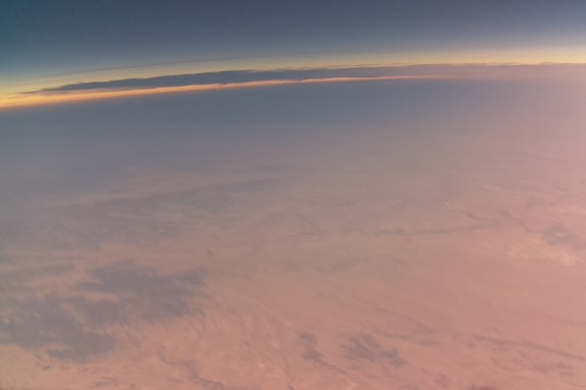
Results (2 of 9)
Eclipse captured via Digital Image Payload

Slide 20
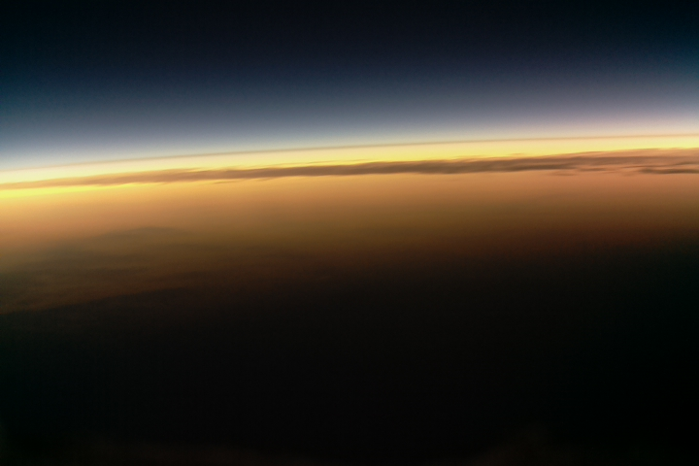
Results (3 of 9)
Eclipse captured (near 60,000 ft) via Digital Image Payload

Slide 21
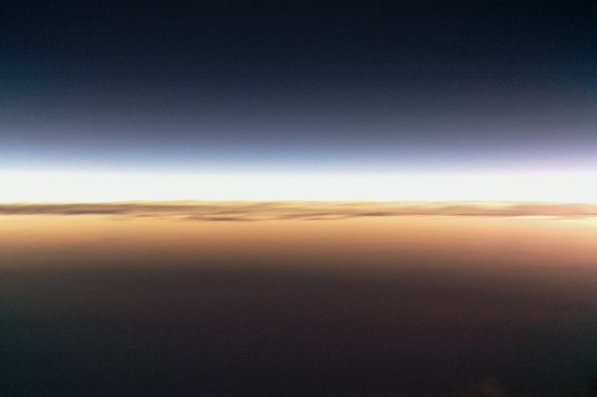
Results (4 of 9)
Eclipse captured (near 60,000 ft) via Digital Image Payload

Slide 22
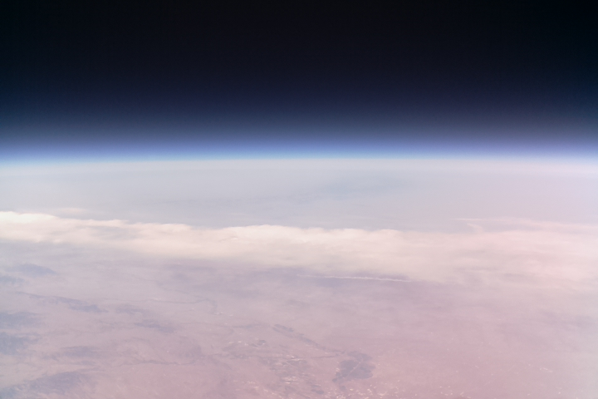
Results (5 of 9)
Near burst (100,000 ft) via Digital Image Payload

Slide 23
Results (6 of 9)
360 Video Payload
  Successfully captured Moon’s shadow move from horizon to horizon during the eclipse
  Post-flight stabilization software developed by Andras Szep and Marton Szep from the University of Arizona
  https://www.youtube.com/watch?v=ztNpjVwYEjs

Slide 24
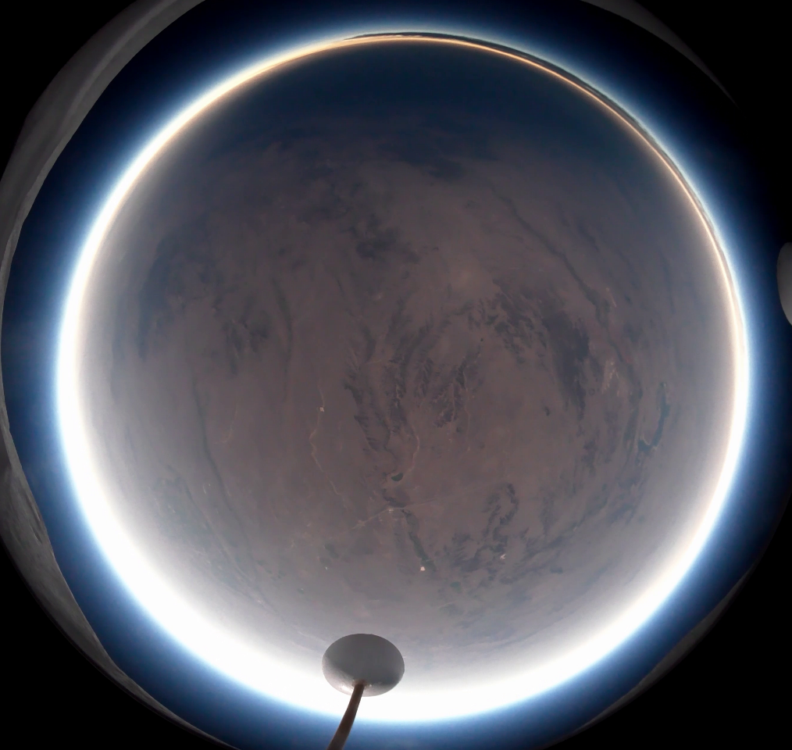
Results (7 of 9)
One frame from the 360 Video Payload Image

Slide 25
Results (8 0f 9)
Digital Video Payload failure
  Damage to stabilizers at launch
  Unable to stream video during flight because could not connect to payload
  Possible power failure of WiFi transceiver
  Unable to connect to payload during flight

Slide 26
Results (9 of 9)
ASU Scientific Payload
  Successfully gathered data on atmospheric conditions
  Observable change in temperature during totality
  Temperature change also recorded at ground station

Slide 27
Conclusion

Slide 28
Conclusion (1 of 1)
Collected useful media in collaboration with a nationwide project
Significant engineering improvements were made to the systems
Developed technology for future flights

Slide 29
Acknowledgements
Arizona Near Space Research
Arizona Space Grant Consortium
Arizona State University, ASCEND Team
Embry-Riddle Aeronautical University, College of Engineering
Louisiana State University
Montana State University
Jack Crabtree
Dr. Tom Sharp
Susan Brew

Slide 30
Questions?
Michael Fusco
  Embry-Riddle Aeronautical University - Prescott
  fuscom@my.erau.edu

